Slide 1

UP, UP and AWAYYY
Project Team
Jared Nieves
Melinda Eudy
Sarah Green
Zehra Tokatli

Slide 2

PROJECT BACKGROUND

Slide 3

Atlanta and Los Angeles.
Being two of the busiest airports in the country and ones that carry a heavy load of international travel.
We wanted to dive into the data to see which countries are flying the most into the two airports.

Slide 5
DATA SOURCES & ETL PROCESS

Slide 6
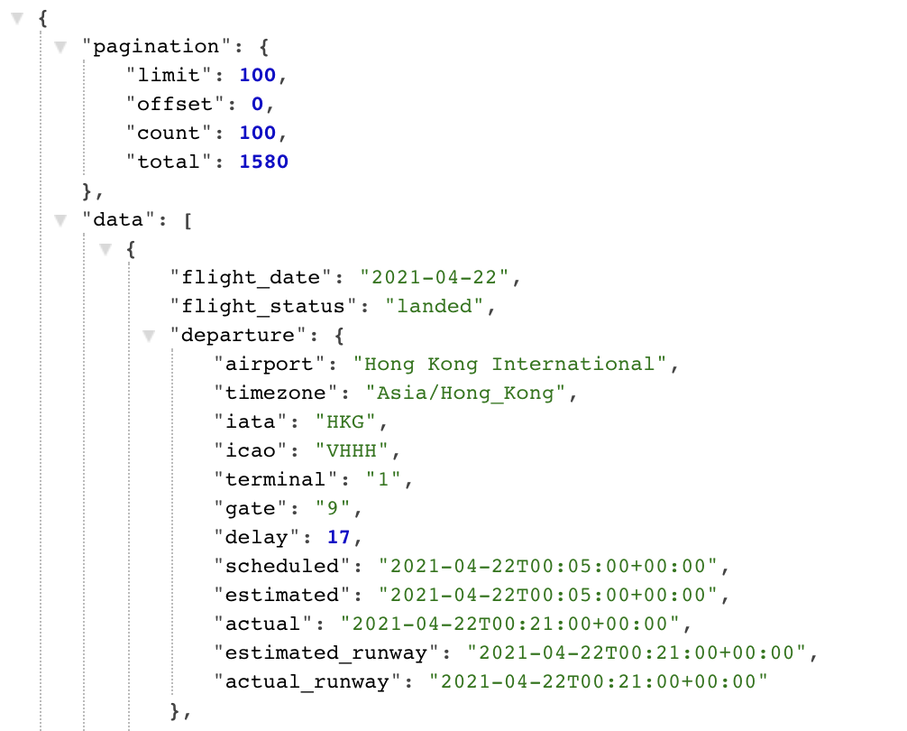
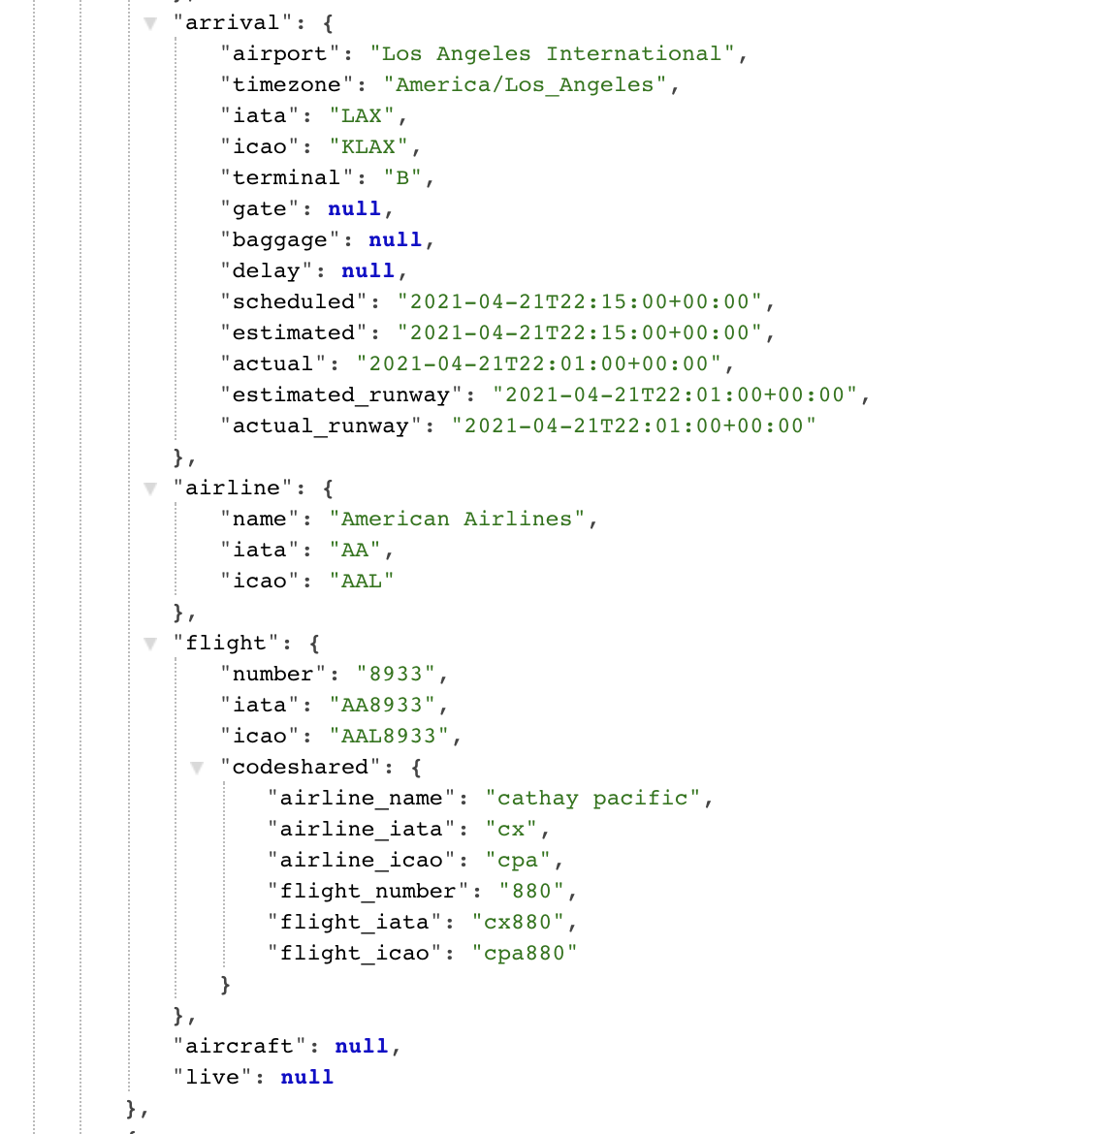
The team leveraged an JSON formatted API from api.aviationstack.com/ containing flights provider information including airports, airlines and flights information.

Slide 7
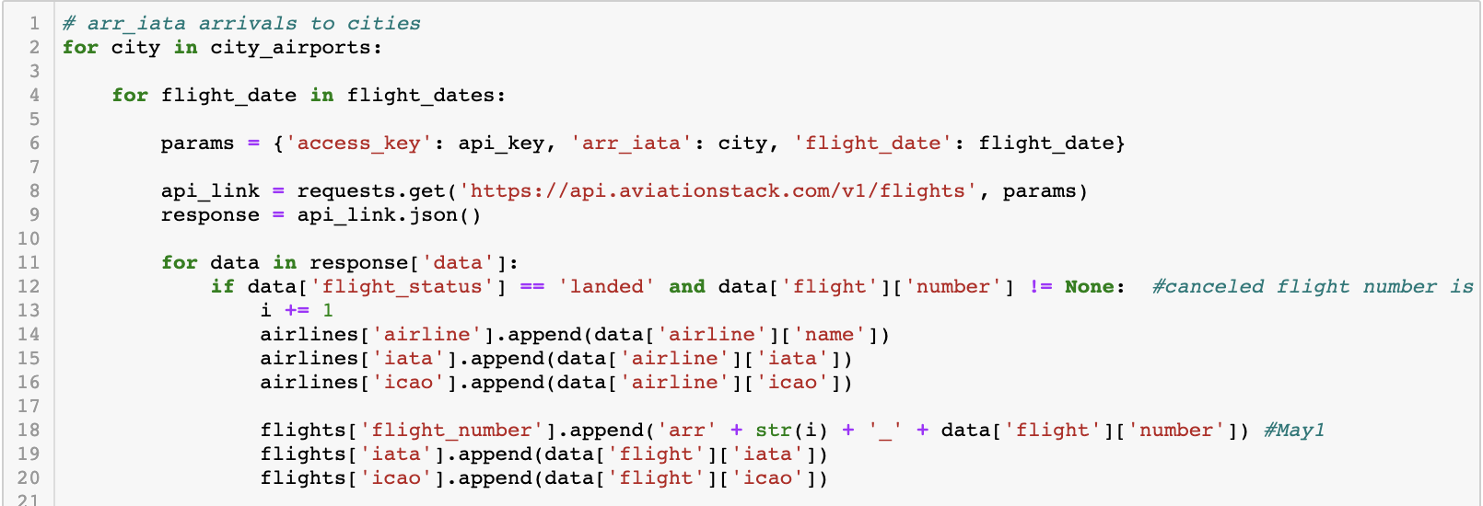
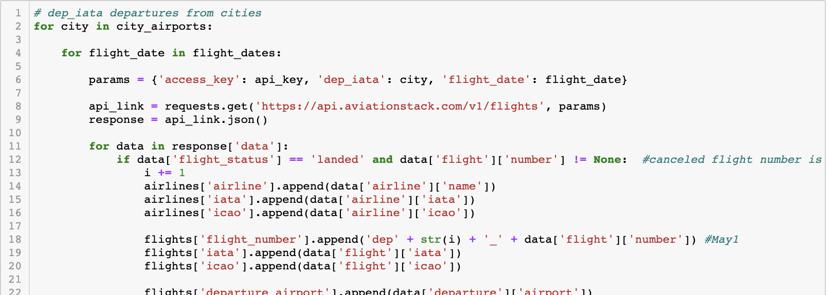

Slide 8
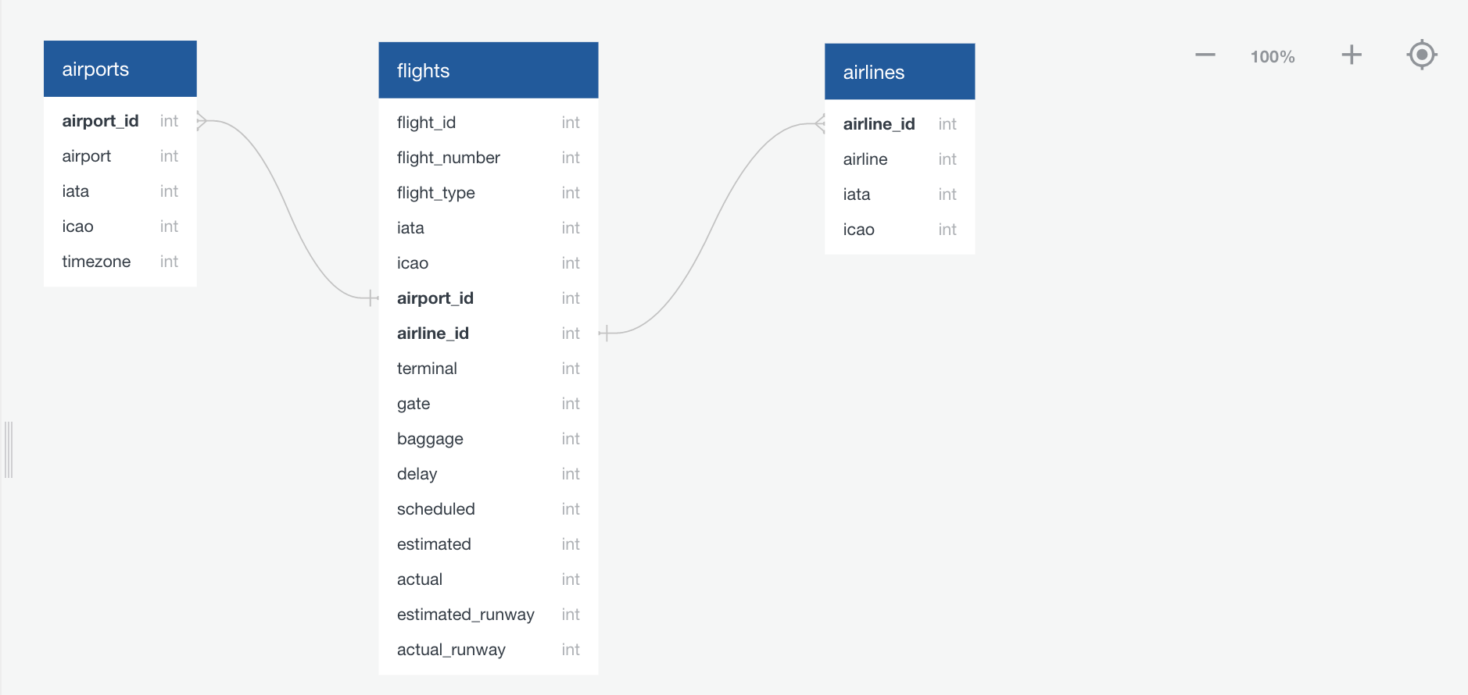

Slide 10
FLASK & PAGE VISUALS

Slide 14

Thank You
Q & A

